Slide 1

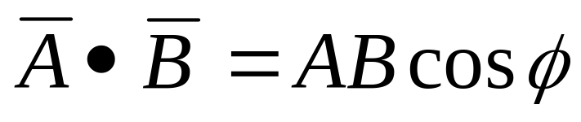
Work and Kinetic Energy
Physics 131
Lecture 9
W = F.x
Today:
Definition of work
Scalar product of two vectors
Force constant and Hooke’s law
Work and Kinetic energy
F = -k x
KE = ½ mv²
All found in Young and Freedman, University Physics, chapter 6, sections 1 to 3 (and chapter 1 section 10 for scalar product of vectors)
Notes:
The methods of problem solving for motion that we have studied are very useful. However, there are times when the situation is so complex that we need to look elsewhere for methods to solve them. Today we’re going to start looking at the principle of conservation of energy and how we can use this to help solve mechanics problems. We’ll learn about kinetic energy and its relationship to a concept called work. In all the situations we look at in this section we are dealing with objects that can be treated as pointlike particles, no rotation or change in shape is allowed of the body. So we’re dealing with motion in a straight line or a curve or even a circle but with no rotation or change in shape.
Here’s a list of what you need to know from this lecture. You have this information on the handout I have given you. The handout also includes the text book references.

Slide 2
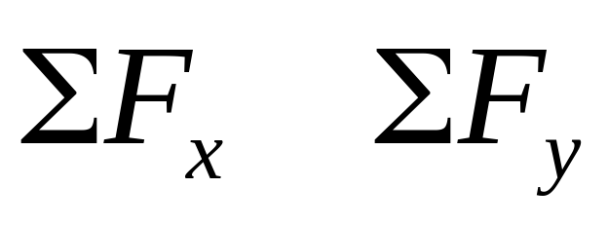
Review
Last lecture we looked at dynamics, specifically:
Applications of Newton’s laws in equilibrium and non-equilibrium situations- non equilibrium F = ma
Free body diagrams then sum forces in x and y directions
T
30⁰
mg
Notes:
Last lecture we looked at
Applications of Newton’s laws in equilibrium and non-equilibrium situations
More problem solving strategies
Solving problems

Slide 3

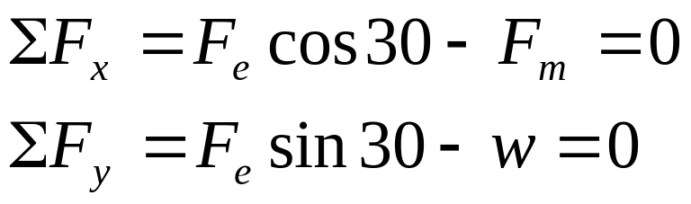


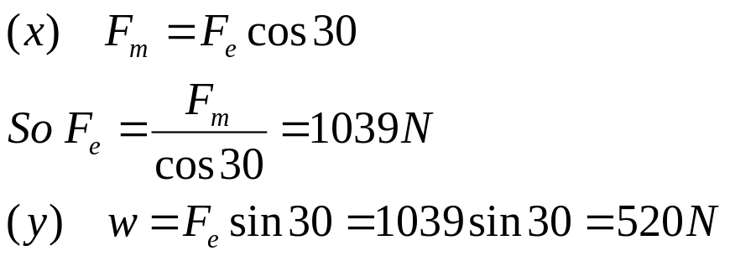
Free body diagram:
Calculate the weight of the alien spaceship, caught in a magnetic tractor beam if it is not accelerating. The tractor beam produces a force of F_{m}= 900 N.
F_{e}
30⁰
F_{m}
w

Slide 4

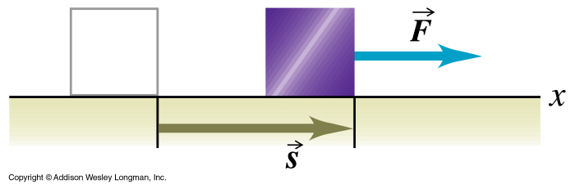
Work
Science definition: Work = Force times distance moved in the direction of the force
W=F.s
It’s SI unit is the Joule, J
Notes:
You usually think of work as something you do to get things done…. If nothing happens you don’t get paid because probably you have done no work….
The same thing happens with work…. If I push a railway car and it doesn’t move… have I done work??
@
These railway workers seem to have hit a snag in their progress….
In mechanics…we are a bit more pricise in what exactly is work….
Work = Force x distance…… so if you apply force to something and it doesn’t move….. No work
Work a measure of energy…. And so its units are Joules.
So if we push a fridge with a force of 200 N a distance of 5 m, how much work have we done ? W=Fs=200*5=1000 J

Slide 5
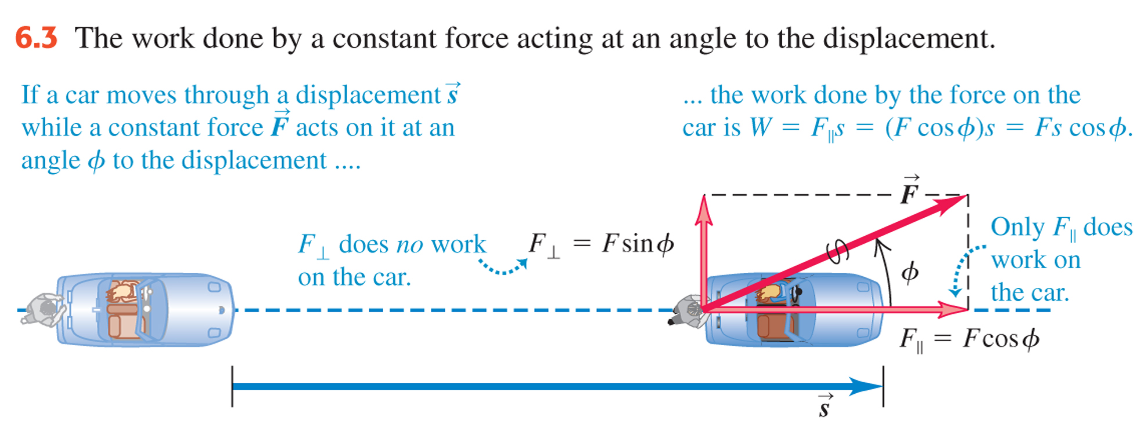
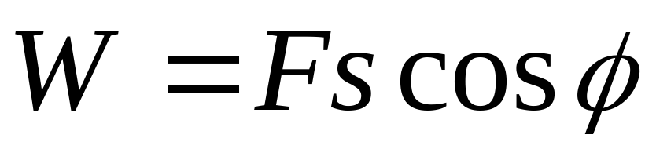
If Force and Work are in different directions
Notes:
What if the force and displacement are not in the same direction ?
In the picture here a man is pushing a car. The force F he is exerting acts at an angle of psi to the direction the car is going. (This may seem unlikely but imagine if the car is on a slope and so gravity will be pulling the car downwards…the resulting force acts in the direction of motion but we’re only interested in what work the man does, not gravity).
If the force is in a different direction… the amound of force in the direction of movement needs to be reduced.
Since not as much force doing the work….
Can you see what vector product is in play here ? It is the scalar product. Let’s go over this quickly.

Slide 6
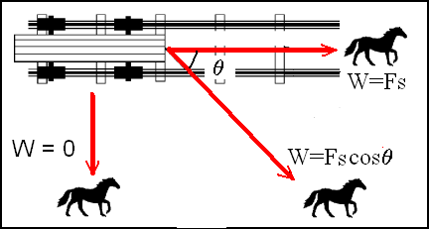
Work on train

Slide 7
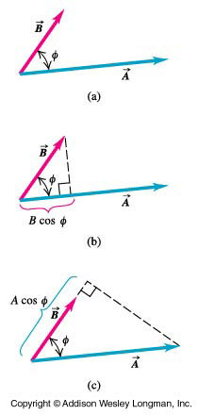
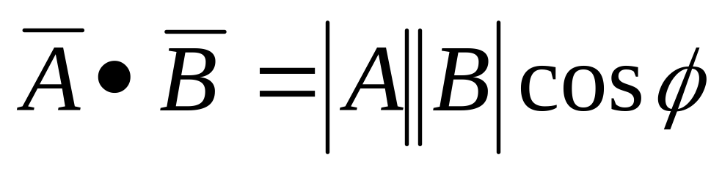
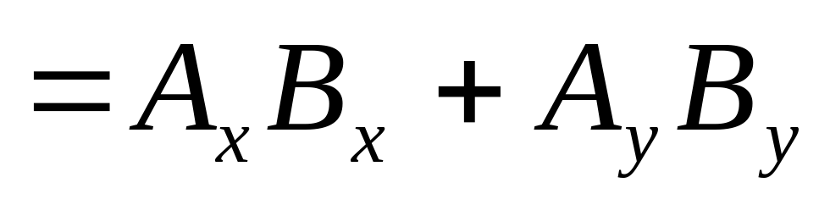
Dot product
The scalar product (or dot product) is defined as the magnitude of vector A multiplied by the component of vector B parallel to vector A. It is a scalar quantity
Notes:
We dealt with vector addition in our first lecture, (and say we did multiplication too if we had time to do it or say what about vector multiplication ?)
Two types of vector multiplication. The one we’re interested in here is The scalar product.
The scalar product (or dot product) is defined as the magnitude of vector A multiplied by the component of vector B parallel to vector A (B COS THI). It is a scalar quantity. Sounds familiar ?
It is written as shown. (looks familiar)
The scalar product of two perpendicular vectors is always zero (cos 90 = 0)
So see that our Fscos psi is the same as the dot product of the vectors F and s

Slide 8


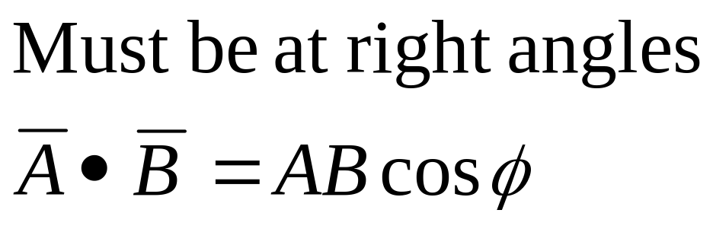
Scalar product

Slide 9


Slide 10
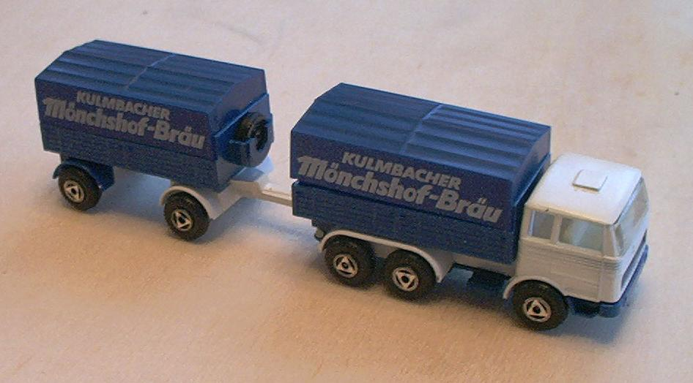
Work
A truck pulls a trailer with a force of 50 N a distance of 20.2 m.
How much work has the truck done on the trailer?

Slide 11
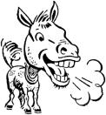
Example: Work
A horse is used to cart coal on a railway track. However the horse doesn’t like walking on the track and makes an angle of 20⁰ to the track. If the horse exerts a force of 3000 N on the rope and the cart moves 1200 m, how much work is done?

Slide 12
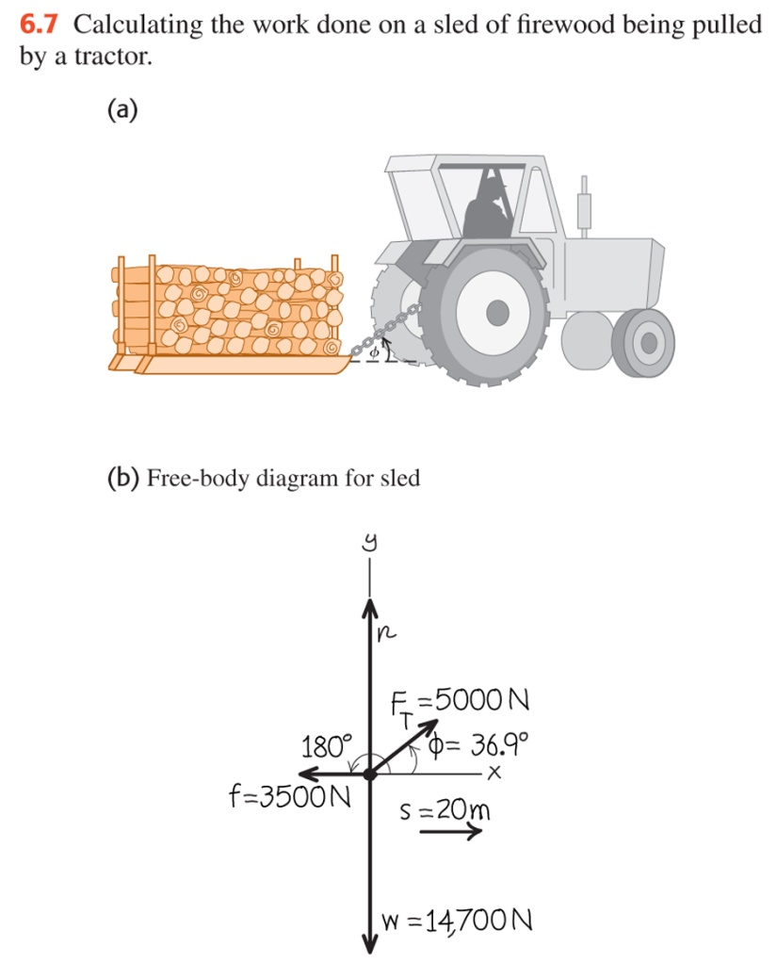
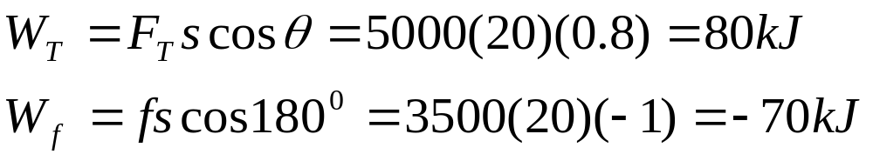
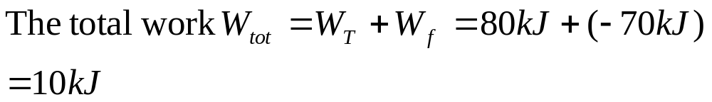
6.2 Work Done by several forces
Farmer Johnson hitches her tractor to a sled loaded with firewood and pulls it a distance of 20 m along level frozen ground. The total weight of the sled and load is 14,700 N. The tractor exerts a constant 5,000 N force at an angle of 36.9⁰ above the horizontal. There is a 3,500 N friction force opposing the motion. Find the work done by each force acting on the sled and the total work done by all the forces.
Notes:
Example 6.2

Slide 13
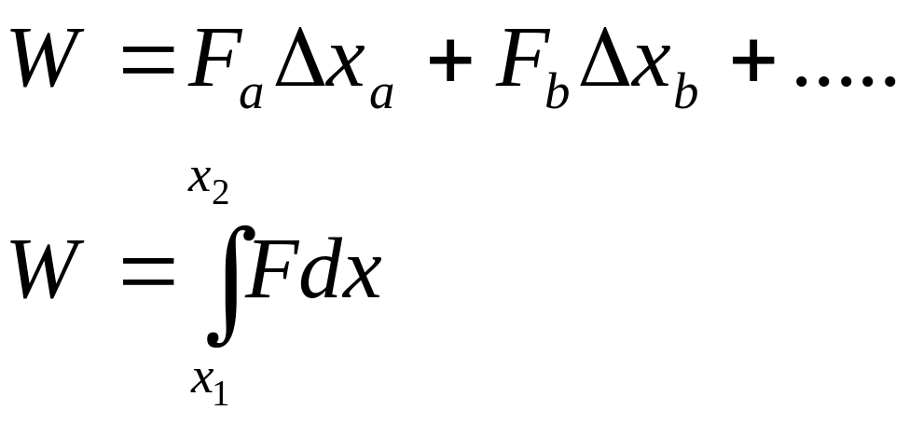
Work done by a varying force
Varying magnitude only
F
Δx
Notes:
So its OK for constant values… what happens if the values Force and direction are not constant….
Lets talk about only a varying force… in a constant direction…..
Well we have work = force times displacement. So what we do is we divide the motion into little bits and then add the work done in each bit together.
This is so we can take very small bits of the motion in which we can assume the force is constant. So we have W = the sum of the F*delta x. The way we sum these bits up is by using the integral. So we end up with the equations shown.

Slide 14
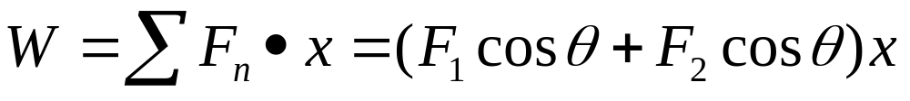
Work done by a varying direction
F₁
y
F₂
x-direction of movement
Notes:
What about if direction changes….. We need to allow for forces in different directions… so use costheta factor….to find the force component in the direction of motion…..
If the angle theta is 90 degrees - cos 90 = 0 so no force in the direction of movement.

Slide 15

Work

Slide 16
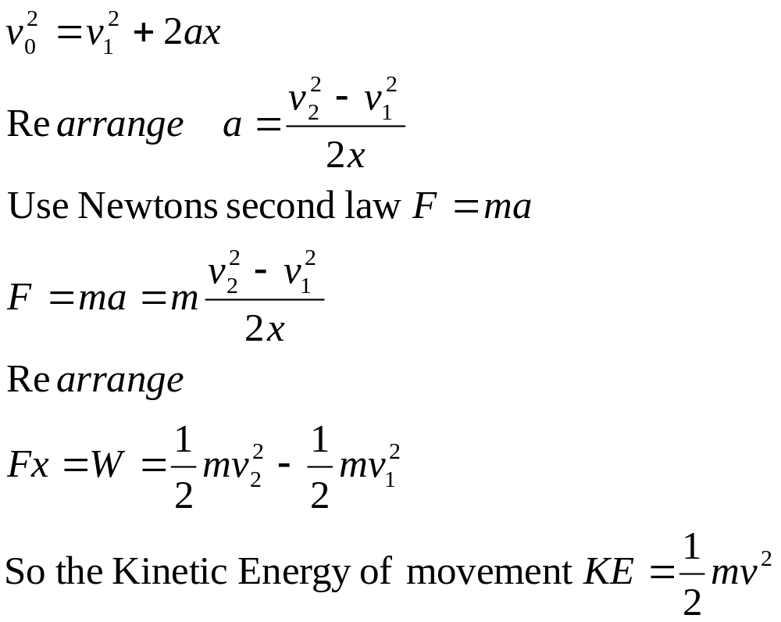
Kinetic Energy= energy of movement
Derivation of equation

Slide 17

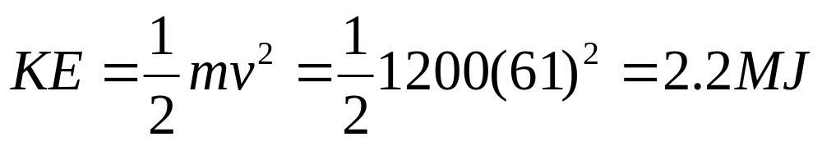
Energy of Racing Car
A Formula 1 racing car weighs 1200 kg and is travelling at 61m/s. How much Kinetic energy does the car have?

Slide 18


Slide 19

How much energy is stored in a spring?
Need to first know how much the spring moves in response to force
=Hooke’s Law

Slide 20
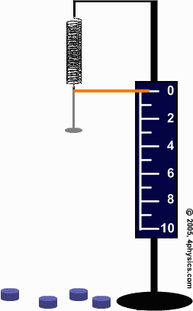
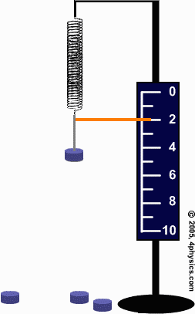
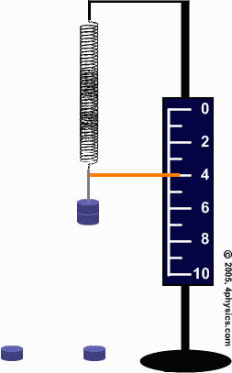
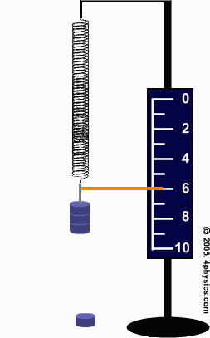
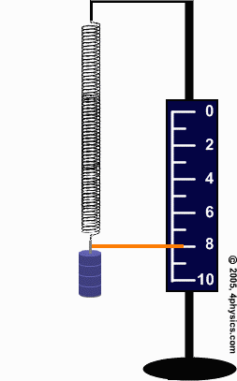
cm
cm
cm
cm
cm
Add 50 g lab masses one by one and measure the weight

Slide 21
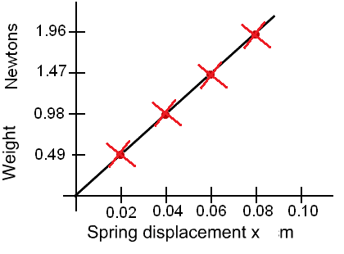
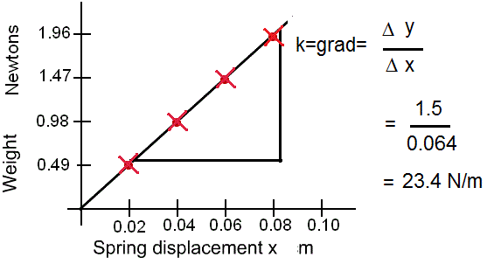
Plot weight against displacement on graph. Straight line so can use equation of line. y = mx+b
b = 0
So F=kx where k is gradient
Measure gradient

Slide 22
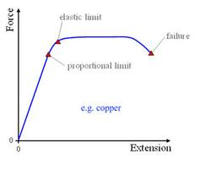
Where Hookes Law does not apply
Once k of spring is found, can relate Force to stretch of spring
F=kx

Slide 23
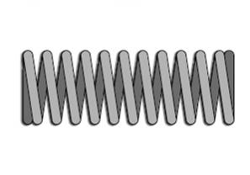
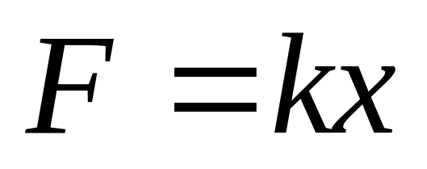
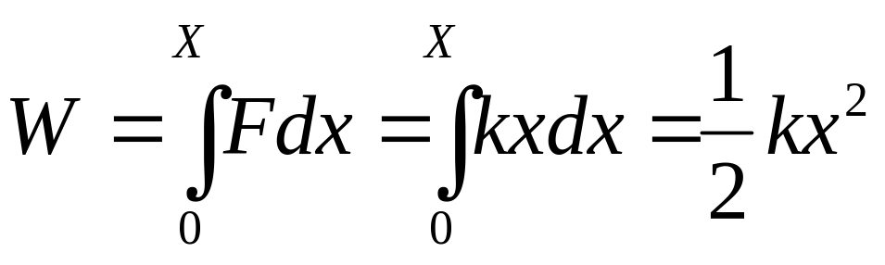
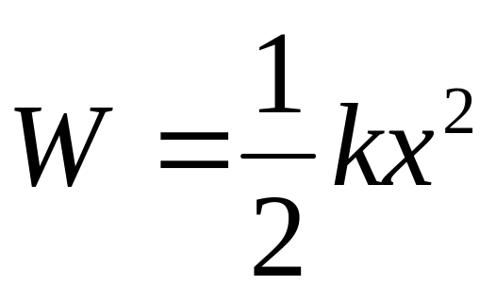
Work done by a varying force – stretched spring
Where k is the force constant – Hooke’s Law
Notes:
Lets do an example….a spring.
The more you strech a spring the harder you have to pull, so the force you exert is not constant. ….. But proportional to the displacement x
So F = kx
The more you stretch a spring the harder you have to pull, so the force you exert is not constant. Usually the direction of the force is constant so we’re dealing with the first case. W=integral of F dx. In the case of a stretched spring we find that F=kx where k is a constant called the force constant of the spring.
If we put this into our equation assuming that the spring is initially unstretched, we get W=1/2 k X² (see slide), where X is the final extension of the spring. This is for the case where the spring is initially unstretched. If it is at a point x1 before it is stretched and then at x2 after we get the bottom equation.

Slide 24
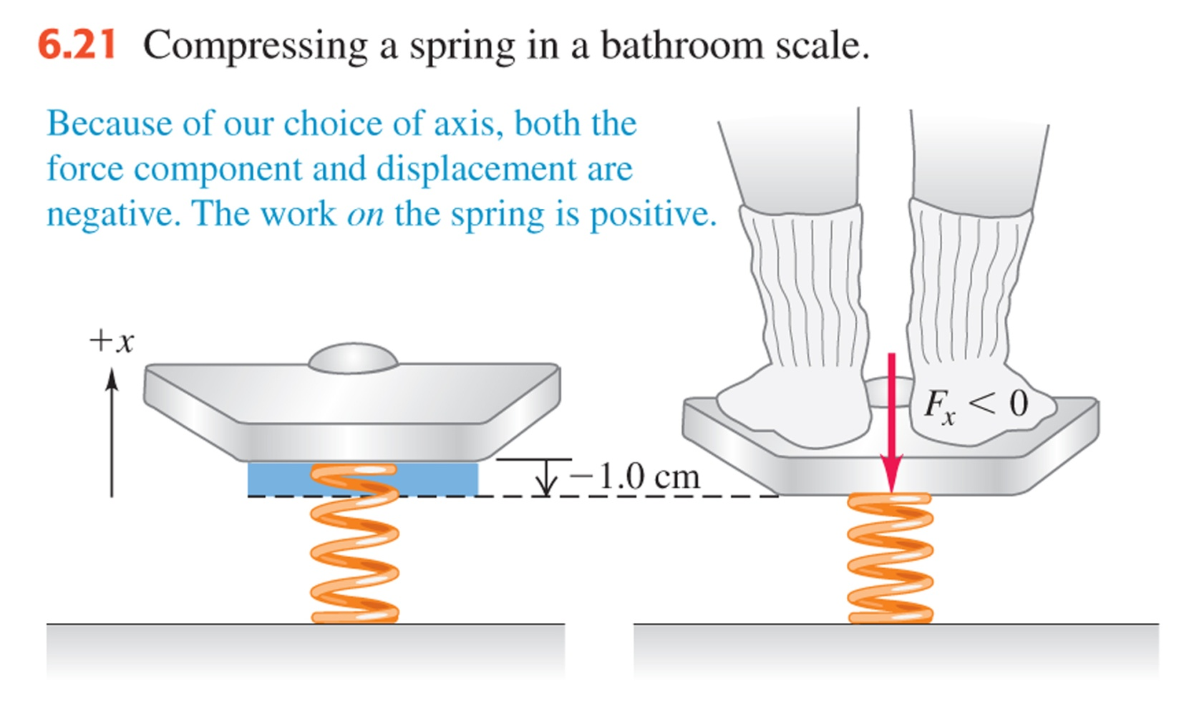
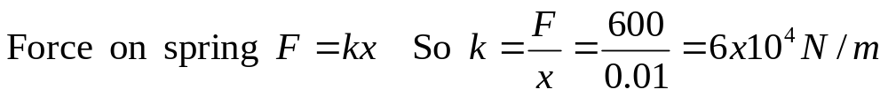
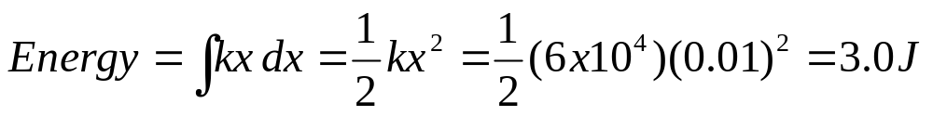
Example 6.6 Work done by a varying force – stretched spring
A woman weighing 600 N steps on a bathroom scale containing a stiff spring. In equilibrium the spring is compressed 1.0 cm under her weight. Find the force constant of the spring and the total work done on it during the compression.
Notes:
Let’s look at an example problem. (Problem 2 : 6-7).See sheet

Slide 25
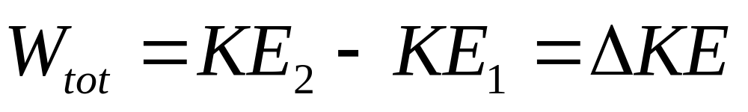
The work-energy theorem for both constant and varying force
The work done by the net force on a particle equals the change in the particle’s kinetic energy
The kinetic energy of a particle is equal to the total work that was done to accelerate it from rest to its present speed
Notes:
Let’s now look at the relationship between work and kinetic energy. Work was defined as W=F*s so we have a force here. What do we know about the motion of a particle when there is a force present ? Newton’s 2nd law…F=ma so the particle undergoes accn which means its velocity changes. Let’s see how we get to the work-energy theorem that is here on the
Another way of looking at kinetic energy is as follows. The kinetic energy of a particle is equal to the total work that was done to accelerate it from rest to its present speed. We can reverse this and say that the kinetic energy of a particle is just equal to the total work that particle can do in the process of being brought to rest.eg when catching a ball, the ball has a certain kinetic energy and this becomes work it does against the hand that catches it, bringing it to rest. In order to make sure the force is as small as possible (and hence minimise pain !) from W=F*d the catcher makes d as big as possible…moves her hand so that the force can be less whilst the W remains equal to ½ mv squared.

Slide 26
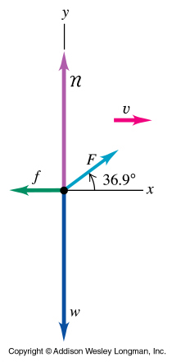
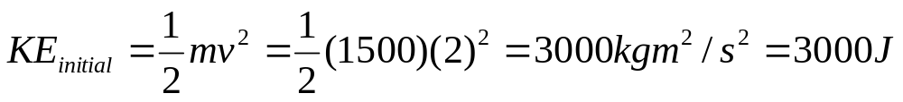
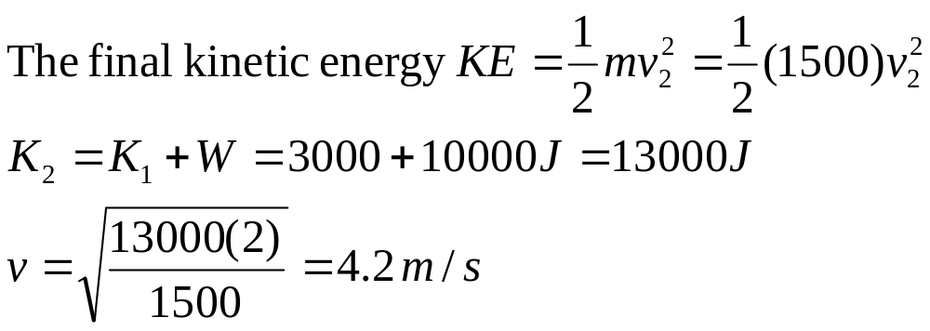
6.4 Work/Energy related to speed
Remember the sled we looked at that was being towed by the tractor ? We worked out that the total work done on the sled was 10,000 J. So the kinetic energy must increase by this much. We know the mass of the sled (w/g) =1500 kg. Suppose that the initial speed v₁ is 2.0 m/s, calculate the final speed.
Notes:
Lets’ do a couple of examples. EXAMPLE 3. Remember the sled we looked at that was being towed by the tractor ? We worked out that the total work done on the sled was 10,000 J. So the kinetic energy must increase by this much. We know the mass of the sled (w/g =1500 kg). Suppose that the initial speed v1 is 2.0 m/s, calculate the final speed.SEE SHEET

Slide 27

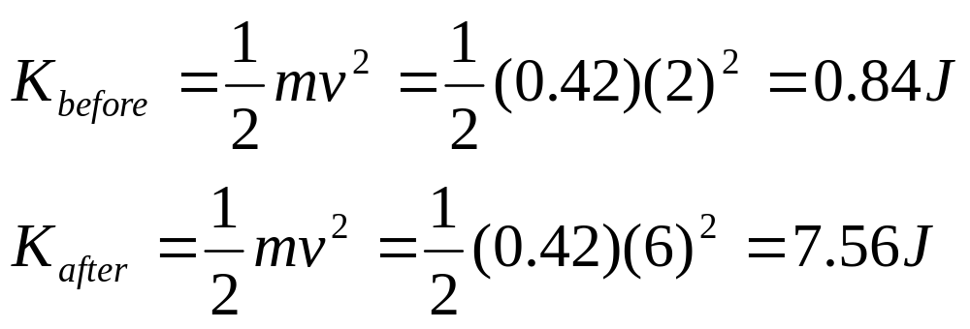
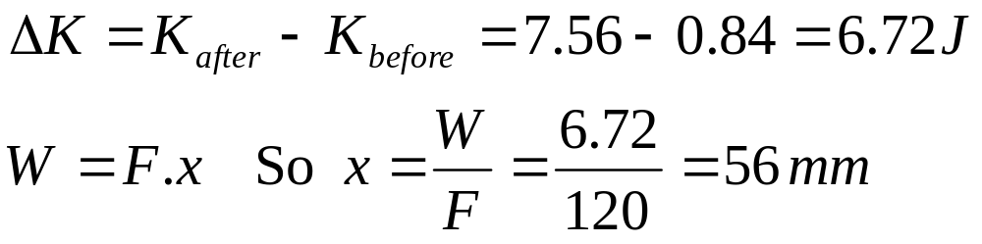
Kicking soccer ball
A soccer ball with mass 0.420 kg is initially moving with speed 2.00 m/s. A soccer player kicks the ball, exerting a constant force of magnitude 120.0 N in the same direction as the ball’s motion. Over what distance must her foot be in contact with the ball to increase the ball’s speed to 6.0 m/s ?
Notes:
Lets’ do another example. EXAMPLE 4.

Slide 28
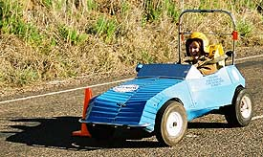
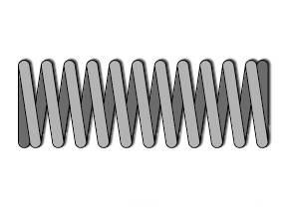
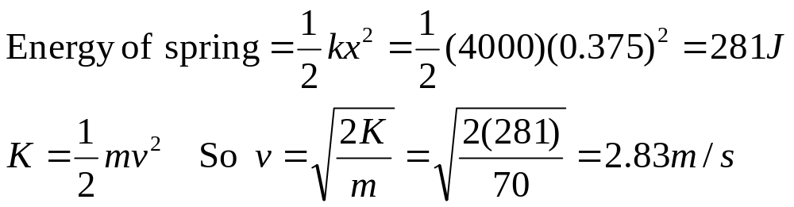
Example: Energy from spring→Velocity
At a park, billycarts with riders are sent along a horizontal surface by the release of a large compressed spring. The spring has a force constant k = 4000 N/m and negligible mass. One end is in contact with a stationary wall. A sled and rider with total mass 70.0 kg are pushed against the other end, compressing the spring 0.375 m. The sled is then released with zero initial velocity. What is the billicart’s projected speed?
Notes:
Lets’ do another example. EXAMPLE 5.

Slide 29
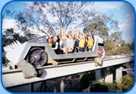
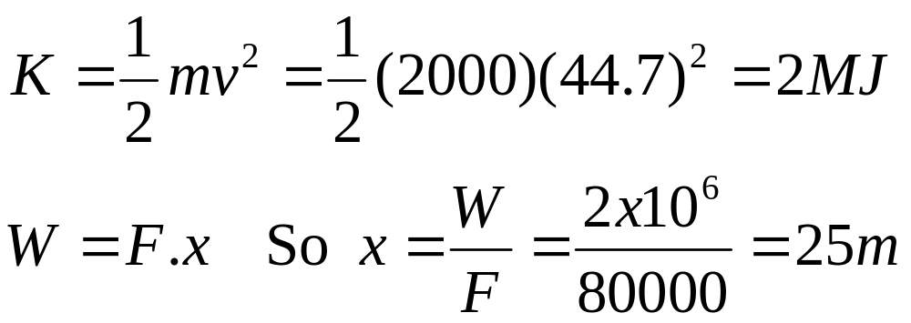
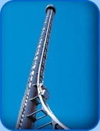
Example- The tower of Terror in Dreamworld
The force applied by the magnetic motor is 80 000 N. This force is needed to be applied to what length of track to make the 2000 kg cart reach the needed speed of 44.7 m/s?
115 m
Notes:
Lets look at the stats.
2.2 MW of electrical power in the form of a magnetic- Linear synchronous motor
The curve pulls about 4gs The initial acceleration is abnout this.
Pilots in planes can withstand 5gs before they black out. A modern fighter jet can withstand about 10gs before the wings start falling off.

Slide 30
